Slide 1
Remote timer jobs and event receivers
Name
Role
Company

Slide 2
Agenda
Introduction
Remote Timer Jobs
Remote event receivers
App events

Slide 4
Recommendations
Remote event receivers is not for synchronization tasks
You can use WebJobs also for async tasks
Avoid long operations in app events
Remote timer jobs for scheduled tasks
Notes:
Vesa

Slide 5
Introduction

Slide 6
Placing the code outside of the SharePoint
Notes:
Vesa

Slide 7

Remote business logic
Remote timer jobs
Scheduled tasks running out side of the SharePoint, but operating towards SharePoint sites or Office 365 services
Remote event receivers
Business logic for end user operations placed outside of the SharePoint, but can access SharePoint for further operations if needed
Notes:
Vesa

Slide 8
Remote Timer Jobs

Slide 9

Remote timer jobs
What
Scheduled tasks using app model techniques
Replacement model for classic server side timer jobs
Why
Performed operations using either scheduled execution or one time asynchronous operation
How
Use Azure worker processes or Web Jobs for scheduled operations
User either app only token or specific accounts for authentication
Can be hosted in on-premises as scheduled task in operating system level or even as a windows service

Slide 10
Remote timer job
Scheduled execution which accesses the needed resources from the SharePoint service and performs the required automation.
Can use either specific account for connection or oAuth based app-only token approach
SharePoint Service
2
Provider Hosted Apps
1
Remote timer job

Slide 11
“Performance of code running outside of the SharePoint is lower than server side…”
Correct.
There’s already hundreds of timer jobs running native in the SharePoint, is placing your code among those really the only option compared to adding the code to clean platform?
Notes:
Vesa

Slide 12
Authentication options
App only token
Register app id and secret, which is used by the remote timer job to access Office 365
Set app id and secret for the remote timer job in app config or using other means
Tokens can be revoked in the server side
Not all functionalities work with app only tokens
Use specific account
Use specific account for accessing Office 365 which has required license and permissions to needed services
Similar as classic service account model in on-premises
User identity and password has to be stored in the location where code is executed

Slide 13
Remote timer job
Demo
https://github.com/OfficeDev/PnP/tree/master/Samples/Core.SimpleTimerJob

Slide 14
Remote timer job for async tasks
What
User remote timer jobs also for one time asynchronous operations
Why
Ensure that end user operations are fast, but start still long lasting operations as needed
How
Spin up remote timer job queues for process. Exact model depends on used technology, but storage queues and web jobs are excellent model for Azure based app model implementation

Slide 15
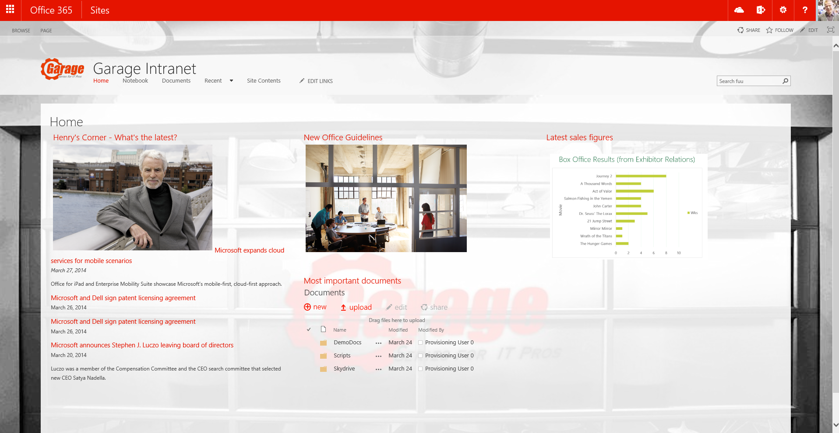
Asynchronous pattern with WebJobs
Provider Hosted Apps
2
SharePoint
<<Run app functionality>>
<<Add message>>
1
Storage Queue
3
<< Perform needed actions>>
<<instantiate>>
WebJob
4

Slide 16
“You do not expose as many remote APIs as what we were able to access server side.”
Correct.
And never will. Many of the server side APIs are targeted on farm or web application level, which are not available in Office 365. We will continue exposing new APIs from site level based on your input.
Notes:
Vesa

Slide 17
Remote event receivers

Slide 18
Remote event receivers
What
Process events from SharePoint using custom code
Why
To react on user or customization actions done in the host web
Old pattern was created by event receivers with server-side code
How
Create remote event receivers
Registration can be done either using server-side or client-side code
External web service is called when events in host web occur

Slide 19
Remote event receivers
SharePoint is increasingly acting as a data hub
In previous versions, there was no way to inform external systems of events
Highly-requested capability by customers, now included in SharePoint2013
External lists also support events
Notes:
SharePoint is increasingly used as the hub for productivity and collaborative experiences that incorporate and interact with data from a variety of external systems. Capabilities like those offered by Business Connectivity Services offer a powerful infrastructure for surfacing external data inside SharePoint, and SharePoint web services offer an increasing complete set of options for surfacing SharePoint data in outside systems.
SharePoint does not, however, currently provide a convenient mechanism for informing external systems of SharePoint events. As a result it is effectively impossible to build an efficient solution that reacts to changes in SharePoint data, except through complex, farm-deployed solutions that use custom event receivers and web service interfaces to call into external systems. Given that farm-deployed solutions are not allowed in Microsoft SharePoint Online, even this solution is not available to Office 365 customers.
In addition, the current sandboxed solution infrastructure imposes quite a few restrictions on the developer. For example, solutions cannot execute for longer than 30 seconds, and they cannot exceed a certain amount of resource usage per day. Allowing a developer to execute their event receiver logic outside of the SharePoint farm makes it possible for them to overcome these restrictions and build more robust solutions.
This was one of the most highly requested features: providing support for external systems to receive events from SharePoint so they can take action based on that event. There are also enhanced capabilities in Business Connectivity Services (BCS) to allow external systems to receive information. We are not talking about BCS in this module—we will talk about that in the BCS module in this course. If you have developed event receivers before, you will find this very familiar and you will be able to take advantage of your skills with this model.

Slide 20
Remote event receivers
Provider Hosted Apps
3
4
LOB System
SharePoint Service
1
Users
Access Control System
2

Slide 21
Remote Event Receivers in SharePoint
Event scopes:
List item
Support for the following types:
Synchronous events
List
Web
App
Asynchronous after events

Slide 22
Remote event receivers – architecture
Not a good choice for “mirroring” or sync solutions
Use remote event receivers to receive notification that a change has occurred
Use interface to poll SharePoint for changes
Write changes as required
No guaranteed delivery
Possible network issues can cause events to fail
Notes:
Remote event receivers are not good for mirroring or sync solutions. We have seen where people have tried to use event receivers to synchronize data between farms or to update databases when data is changed. These are not good uses of event receivers in either model, but particularly with remote event receivers because there is no guaranteed delivery. You will not have that message queued up for delivery and then you will wait for the remote endpoint to come back online to continue processing. The remote endpoint has to be online and listening for the delivery to occur. You can write some custom code to try to improve this, but you do not receive that out of the box.

Slide 23
Remote event receivers – tooling
Add a remote event receiver as a new item
Note: This wizard is only for events in app web.
Notes:
Remote event receivers can be added directly to app projects.

Slide 24
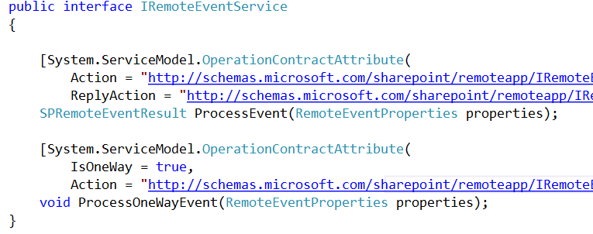
Remote event receivers – interface methods
Synchronous and asynchronous events are supported
Notes:
ProcessEvent
The defined interface supports “ING” events and synchronous “ED” events. ING events occur before the actual event, such as the actual adding of an item to a list or the actual deleting of an item in a list. In this version of SharePoint, we can also specify the ED events, meaning notification after the event has occurred—we can specify that the call is processed synchronously.
ProcessOnewayEvent
The defined interface supports asynchronous “ED” events.
The web service takes a single argument of type SPRemoteEventProperties and returns SPRemoteEventResults for synchronous events.
The web service takes a single argument of type SPRemoteEventProperties and returns void for “ED” events.
SPRemoteEventProperties will always pass an EventType property, which describes the type of event that is occurring or has occurred. In addition, one of ItemEventProperties, ListEventProperties, or WebEventProperties will be passed, depending on the EventType.
For “ING” events, the web service will respond with an object of type SPRemoteEventResult, which will specify the status of the event and, if applicable, the list of changed properties, an error message, and/or a redirect URL.
The remote event receiver web service caller will only support calling SOAP-based web services.
The web service caller will use XML serialization.
The web service caller will depend on the outbound Oauth authentication scheme.

Slide 25
Remote event receivers - Calling back into SharePoint
public SPRemoteEventResult ProcessEvent(SPRemoteEventProperties properties)
{
SPRemoteEventResult result = new SPRemoteEventResult();
using (ClientContext clientContext = TokenHelper.CreateAppEventClientContext(properties, useAppWeb: false))
{
if (clientContext != null)
{
clientContext.Load(clientContext.Web);
clientContext.ExecuteQuery();
}
}
return result;
}
Notes:
The boilerplate code that is generated by Visual Studio looks similar to the code above. We use the CreateRemoteEventReceiverClientContext method of the TokenHelper class to obtain a client context based on the context token that is passed to the WCF service. The end result is that you will have a client context that will be used to call back into SharePoint, making advanced scenarios possible where we call back into SharePoint for further processing. The system used to call back into SharePoint, security tokens, and Oauth are not covered in detail in this module—we will review these in another module. In this module, we just want to focus on the fact that it is possible to retrieve the token to be used to make a call back into SharePoint.

Slide 26
Remote event receivers – registration Using server-side object model – requires access to server
string url= "http://contoso.com/RemoteEventService.svc";
using (SPSite site = new SPSite(siteUrl))
{
using (SPWeb web = site.RootWeb)
{
SPList list = web.Lists[listTitle];
list.EventReceivers.Add(
SPEventReceiverType.ItemAdded,
url);
}
}
Notes:
The object model associated with remote event receivers functions identically to SPEventReceiverDefinition, except that it will have an additional URL property, and the Assembly and Class properties will not be used.

Slide 27
Remote event receivers – registration Client-side object model implementation
var web = clientContext.Web;
clientContext.Load(web);
clientContext.ExecuteQuery();
var col = web.EventReceivers;
clientContext.Load(col);
clientContext.ExecuteQuery();
EventReceiverDefinitionCreationInformation newEventReceiver
= new EventReceiverDefinitionCreationInformation()
{
EventType = EventReceiverType.ListAdded, ReceiverName = "CustomRemote-ListEventReceiver",
ReceiverUrl = remoteEventUrl, SequenceNumber = 1000
};
web.EventReceivers.Add(newEventReceiver);
clientContext.ExecuteQuery();
Notes:
The object model associated with remote event receivers functions identically to SPEventReceiverDefinition, except that it will have an additional URL property, and the Assembly and Class properties will not be used.

Slide 28
Remote event receivers
Demo
https://github.com/OfficeDev/PnP/tree/master/Samples/Core.EventReceivers

Slide 29
“Any reliable alternatives for remote event receivers?”
Workflow
Depending on the business scenario, you might want to check the possibility to use workflows as the event processing engine.
Notes:
Vesa

Slide 30
App installation events

Slide 31
App event receivers
What
App installed, app uninstalling, app upgraded events
Why
Include possible additional operations as part of the app installation for example to modify host web based on business requirements.
How
Only available for provider hosted apps. Register event and handle event in web service located in the provider hosted app side.

Slide 32
App event considerations
App installation is queued as timer job task which is typically executed immediately, but can be delayed depending on environment load
30 second time out for operations (4 retries) which can result multiple calls to install event
Overall time out is 5 minutes
Consider async operations or run needed code when app is accessed first time
App uninstalled will happen when app is deleted from the recycle bin

Slide 33
Asynchronous App Installed handling
Provider Hosted Apps
2
SharePoint
<<App Installed>>
<<Add message>>
1
Storage Queue
3
<< Perform needed actions>>
<<instantiate>>
WebJob
4

Slide 34
Debugging app event receivers
Demo
https://github.com/OfficeDev/PnP/tree/master/Samples/Core.EventReceivers

Slide 35
Recommendations
Remote event receivers is not for synchronization tasks
You can use WebJobs also for async tasks
Avoid long operations in app events
Remote timer jobs for scheduled tasks
Notes:
Vesa

Slide 36
Questions?

Slide 37

Sharing is caring…
Reusable code samples
Guidance documentation
Monthly community calls
Case Studies
SharePoint Framework
SharePoint add-ins
Microsoft Graph
Remote API access
http://aka.ms/SharePointPnP

Slide 38


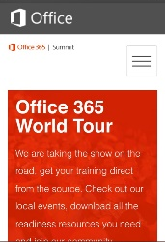
dev.office.com
Sign up
http://dev.office.com/getting-started
Explore
http://apisandbox.msdn.microsoft.com
Get trained http://dev.office.com/training

Slide 39


Feedback
Office 365 Network Share you best practices and join conversations
https://www.yammer.com/itpronetwork
Stackoverflow Ask deep technical questions to a world-wide set of developers
http://stackoverflow.com/questions/tagged/ms-office
UserVoice Provide suggestions of what you want in future versions
http://officespdev.uservoice.com/

Slide 40


© 2015 Microsoft Corporation. All rights reserved. Microsoft, Windows, and other product names are or may be registered trademarks and/or trademarks in the U.S. and/or other countries.
The information herein is for informational purposes only and represents the current view of Microsoft Corporation as of the date of this presentation. Because Microsoft must respond to changing market conditions, it should not be interpreted to be a commitment on the part of Microsoft, and Microsoft cannot guarantee the accuracy of any information provided after the date of this presentation. MICROSOFT MAKES NO WARRANTIES, EXPRESS, IMPLIED OR STATUTORY, AS TO THE INFORMATION IN THIS PRESENTATION.

